Slide 1
Lecture 2
History of Operating Systems

Slide 2
Early History: The 1940s and 1950s
Operating systems evolved through several phases.
  1940s:
    Early computers did not include operating systems.
  1950s:
    Executed one job at a time.
    Single-stream batch-processing systems.
    Included technologies to smooth job-to-job transitions.
    Programs and data submitted consecutively on tape.

Slide 3
The 1960s
Batch-processing systems still in use.
Turnaround time (the time it takes to receive finished reports after submission of documents or files for processing ) was reduced to minutes or seconds.
Multiprogramming: Process multiple jobs at once; one job could use processor while other jobs used peripheral devices.
Timesharing: Advanced operating systems developed to service multiple interactive users.
Real-time systems: response within certain bounded time period.
In 1964 IBM announced System/360 family of mainframe computers.

Slide 4
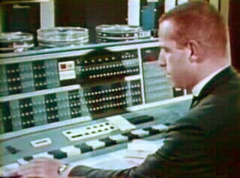
The 1960s
CTSS (Compatible Time-Sharing System) was one of the first time-sharing operating systems; it was developed at MIT's Computation Center.
  CTSS was first demonstrated in 1961, and was operated at MIT until 1973.
  CTSS used a modified IBM 7094 mainframe computer.
  Louis Pouzin created a command called RUNCOM for CTSS, which executed a list of commands contained in a file. (batch file)
1964: MIT, GE, Bell Labs started the Multics project.
  Multics was a commercial OS based on CTSS.
  Last working copy was shut down on 31 Oct 2000.

Slide 5
The 1970s
Primarily multimode timesharing systems:
  Supported batch processing, timesharing and real-time applications.
  Personal computing only in incipient stages fostered by early developments in microprocessor technology. (Xerox Alto)
  Mouse and Graphical user interfaces (GUI) developed by Xerox’s PARC for the Xerox Alto computer.
Networking
  The US Department of Defense develops TCP/IP:
    Standard communications protocol.
    Widely used in military and university settings.
  Xerox’s Palo Alto Research Centre (PARC) – Ethernet.
  Security problems: Growing volumes of information passed over vulnerable communications lines. → Encryption.

Slide 6
The 1980s
Decade of personal computers and workstations.
Computing distributed to sites at which it was needed.
IBM PC released in 1981.
Personal computers proved relatively easy to learn and use.
Apple releases the Macintosh PC in 1984, GUI embedded in the operating system.
Richard Stallman launched the GNU (GNU’s Not UNIX) project in 1983:
  Recreate and extend tools for AT&T’s UNIX operating system.
  He disagreed with concept of paying for permission to use software.

Slide 7
The 1980s
Transferring information between computers via networks became more economical and practical.
Client/server computing model became widespread
  Clients request various services
  Servers perform requested services
Software engineering field continued to evolve
  Major thrust by the United States government aimed at tighter control of Department of Defense software projects
    Realizing code reusability
    Greater degree of abstraction in programming languages
    Multiple threads of instructions that could execute independently

Slide 8
The 1990s
Hardware performance improved exponentially:
  Inexpensive processing power and storage
    Execute large, complex programs on personal computers.
    Economical machines for extensive database and processing jobs.
    Mainframes rarely necessary.
Operating system support for networking tasks became standard.
Shift toward distributed computing rapidly accelerated: multiple independent computers performing common task.

Slide 9
The 1990s
Object technology became popular in many areas of computing:
  Many applications written in object-oriented programming languages (C++, Java)
  Object-oriented operating systems (OOOS): objects represent components of the operating system.
  Concepts such as inheritance and interfaces:
    Exploited to create modular operating systems.
    Easier to maintain and extend than systems built with previous techniques.

Slide 10
The 1990s
Most commercial software sold as object code:
  The source code not included.
  Enables vendors to hide proprietary information and programming techniques.
Free and open-source software became increasingly common in the 1990s:
  Allows individuals to examine and modify software.
  Famous example: In 1991, a student in Finland, Linus Torvalds, released a rudimentary UNIX-like kernel using the GNU compilers and tools and invited contributions worldwide.

Slide 11
The 1990s
Operating systems became increasingly user friendly
  GUI features pioneered by Xerox and Apple widely used and improved.
  “Plug-and-play” capabilities built into operating systems:
    Enable users to add and remove hardware components dynamically.
    No need to manually reconfigure operating system.
Microsoft Corporation became dominant:
  Windows operating systems (Windows 3.0 released in 1990)
    Employed many concepts used in early MacOS.

Slide 12
Early 21st Century
Cloud Computing
http://www.youtube.com/watch?v=hplXnFUlPmg

Slide 13
UNIX
1964 – 69: Multics (Bell Labs, General Electric, MIT):
  All things to all people
  Large, expensive and complex
1969: Bell Labs withdrew form the Multics project
  A small team led by Ken Thompson began designing a pore practical OS for the Bell Labs’ machines
First name: UNICS, joke on the “multi” aspect of Multics.
Spelling eventually changed to UNIX

Slide 14
UNIX
Over the next few years UNIX was rewritten in Thompson’s B language and then in Denis Ritchie’s C language.
AT&T was not allowed to sell UNIX.
  UNIX’s source code was distributed to universities for a small fee.
A group at the University of California at Berkeley modified the UNIX source code to create the Berkeley SOFTWARE Distribution UNIX (BSD UNIX).
  Led by Bill Joy, a co-founder of Sun Microsystems.

Slide 15
UNIX
Sun Microsystems based their SunOS on BSD UNIX.
Later teamed up with AT&T to design Solaris, based on AT&T’s System V Release 4 UNIX.
As an opposition to the AT&T and Sun Microsystems association, a group of developers formed the Open Source Foundation (OSF) to make their own version of UNIX called OSF/1.

Slide 16
UNIX and Linux
In 1987, Prof. Andrew Tanenbaum from the Vrije University in Amsterdam built Minix.
  A stripped-down version of UNIX for teaching OS basics on a PC.
Linus Torvalds, a Finish student, used Minix to begin writing the open-source Linux OS.
Today many companies incl. IBM, HP, Sun Microsystems, and Intel all offer a Linux version as an operating system option for their servers.
Other open-source projects include: OpenBSD, FreeBSD, Net-BSD, IBM’s AIX based on both System V and BSD, HP-UX (a strong competitor to Aix and Solaris).

Slide 17
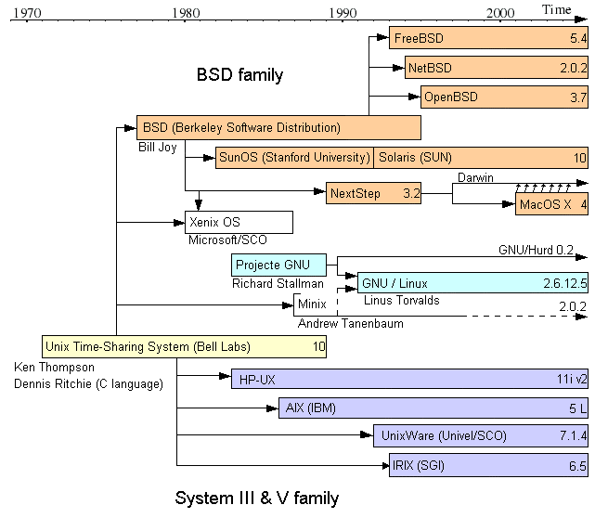

Slide 18
